Slide 1
Regression Analysis

Slide 2
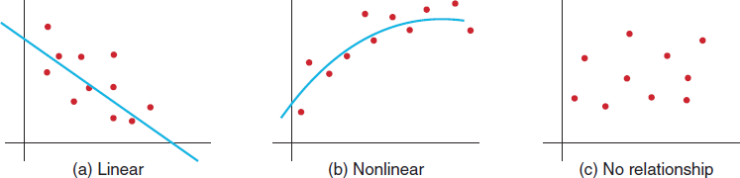
Regression Analysis
It is a tool for building mathematical and statistical models that characterize relationships between
A dependent variable (ratio)
And one or more independent variables (ratio or categorical)
The relationship may be linear, non linear or no relationship at all.

Slide 3
Types of Regression Models
Based on type of independent variable
-Regression model for cross sectional data
-Regression model for time series data
Based on number of independent variable
-Simple regression involves a single independent variable.
-Multiple regression involves two or more independent variable.

Slide 4
Simple Linear Regression
It involves finding a linear relationship between one independent variable X and one dependent variable Y.
Verify that general relationship is linear (scatter plot Home Market Value data)
Express the relationship by a simple linear equation (find best fitting line using Excel Trend tool)

Slide 5
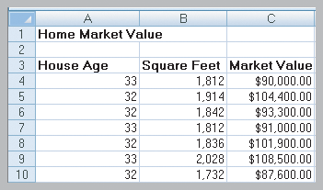
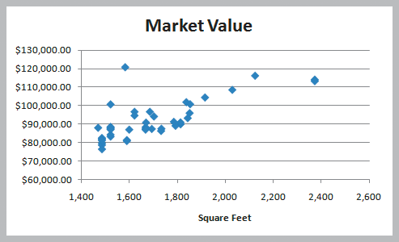
Example: Home Market Value
Size of a house is typically related to its market value.
X = square footage
Y = market value ($)
The scatter plot of the full data set (42 homes) indicates a linear trend.

Slide 6
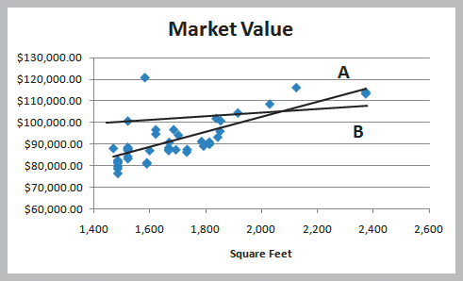
Simple Linear Regression
Finding the Best-Fitting Regression Line
Two possible lines are shown below.
Line A is clearly a better fit to the data.
We want to determine the best regression line.
^
Y = b₀ + b₁X
where
b₀ is the intercept
b₁ is the slope

Slide 7
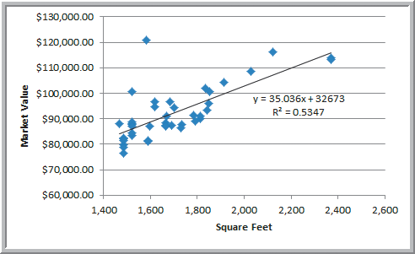
Simple Linear Regression
Using Excel to Find the Best Regression Line
Market value = 32673 + 35.036(square feet)
The regression model explains variation in market value due to size of the home.
It provides better estimates of market value than simply using the average

Slide 8
Simple Linear Regression
Using Excel Functions to Find Least-Squares Coefficients
Slope = b₁ = 35.036
=SLOPE(C4:C45, B4:B45)
Intercept = b₀ = 32,673
=INTERCEPT(C4:C45, B4:B45)
Estimate Y when X = 1800 square feet
Y = 32,673 + 35.036(1800) = $95,737.80
=TREND(C4:C45, B4:B45, 1800)
^

Slide 9
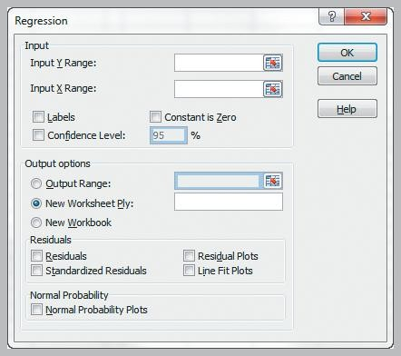
Simple Linear Regression
Excel Regression tool Data
Data Analysis Regression
Input Y Range
Input X Range Labels
Excel outputs a table with many useful regression statistics.

Slide 10
Simple Linear Regression
Multiple R
| r | where r is the sample correlation coefficient
r varies from -1 to +1 (r is negative if slope is negative)
R Square
coefficient of determination, R²
varies from 0 (no fit) to 1 (perfect fit)
Adjusted R Square
adjusts R² for sample size and number of X variables
Standard Error
variability between observed & predicted Y variables

Slide 11
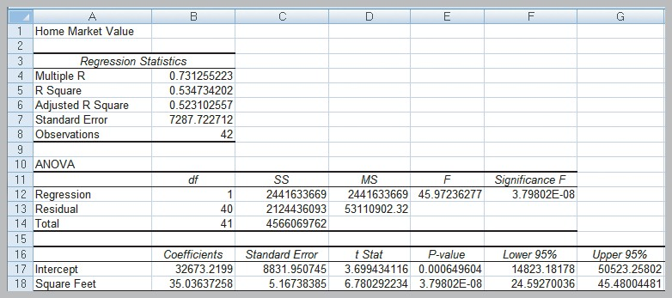
Simple Linear Regression
Interpreting Regression Statistics for Simple Linear Regression (Home Market Value)

Slide 12
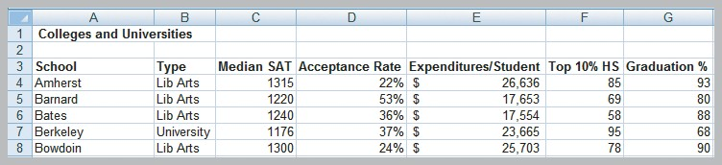
Multiple Linear Regression
Multiple Regression has more than one independent variable.
The multiple linear regression equation is:
Interpreting Regression Results for the Colleges and Universities Data
Colleges try to predict student graduation rates using a variety of characteristics, such as:
Median SAT
Expenditures/student
Acceptance rate
Top 10% of HS class

Slide 13
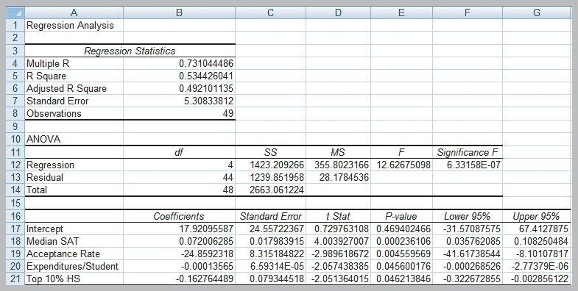
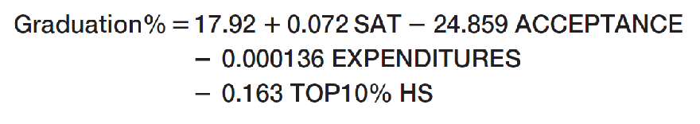
Multiple Linear Regression
Interpreting Regression Results for the Colleges and Universities Data

Slide 14

Multiple Linear Regression
Analytics in Practice:
Using Linear Regression and Interactive Risk Simulators to Predict Performance at ARAMARK
ARAMARK, located in Philadelphia, is an award- winning provider of professional services
They developed an on-line tool called “interactive risk simulators” that allows users to change various business metrics and immediately see the results.
The simulators use linear regression models.

Slide 15
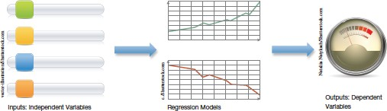
Multiple Linear Regression
Risk metrics are adjusted using sliders.
Allows users (managers and directors) to see the impact of these risks on the business.

Slide 16
Regression with Categorical Variables
Dealing with Categorical Variables
Must be coded numeric using dummy variables.
For variables with 2 categories, code as 0 and 1.
For variables with k ≥ 3 categories, create k−1 binary (0,1) variables.
Interaction Terms
A dependence between two variables is called interaction.
Test for interaction by adding a new term to the model, such as X₃ = X₁X_{2.}

Slide 17
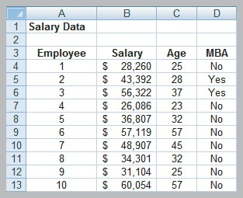
Regression with Categorical Variables
A Model with Categorical Variables
Employee Salaries provides data for 35 employees
Predict Salary using Age
and MBA (yes=1, no=0)

Slide 18
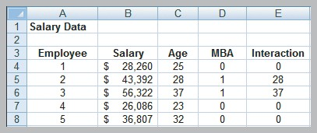
Incorporating Interaction Terms in a Regression Model
Define an interaction between Age and MBA and include in the regression model.
Interaction = (Age)(MBA)

Slide 19
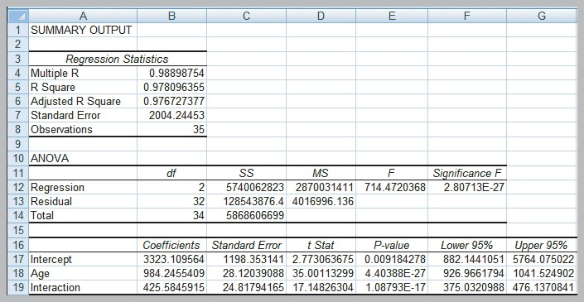
Salary = 3,323 + 984(Age) for those without MBA Salary = 3,323 + 1410(Age) for those with MBA
Adjusted R² = 0.976727
(a slight improvement)

Slide 20
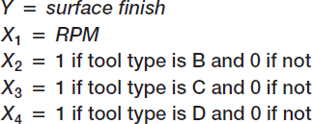
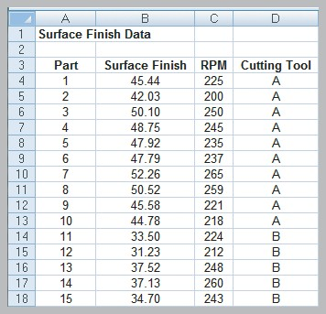
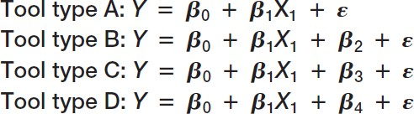
A Regression Model with Multiple Levels of Categorical Variables
Surface Finish data provides measurements for 35 parts produced on a lathe.

Slide 21
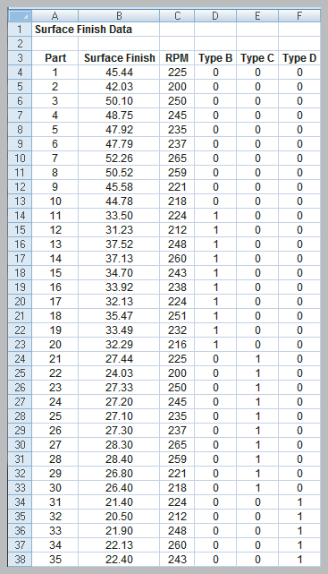
A Regression Model with Multiple Levels of Categorical Variables
Tool Type (A,B,C,D) is now coded as 3 dummy variables

Slide 22
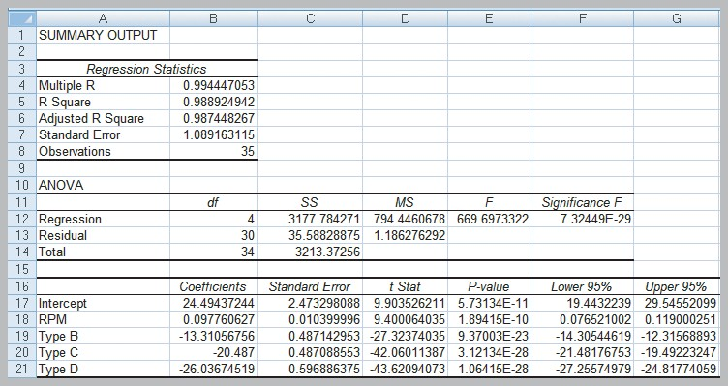
A Regression Model with Multiple Levels of Categorical Variables
Tool A: Surf. Finish = 24.5 + 0.098 Tool B: Surf. Finish = 11.2 + 0.098 Tool C: Surf. Finish = 4.0 + 0.098 Tool D: Surf. Finish = -1.6 + 0.098

